Slide 1
State Estimation of Cylindrical Cells Using Strain and Pressure Sensors
Gregor Glanz
AIT Austrian Institute of Technology
11.02.2026

Slide 2
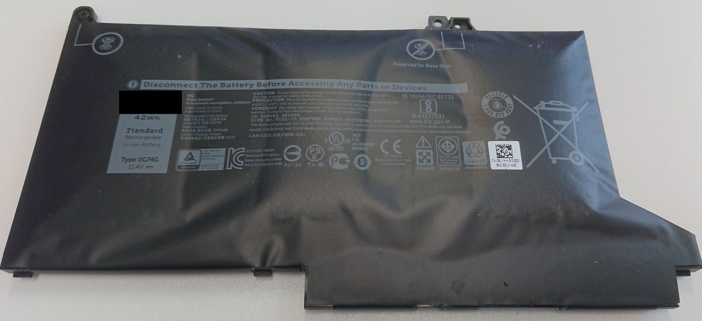
Motivation
The state of a Lithium-Ion battery (LIB) in a battery pack is currently determined with the electrical two-pole behaviour.
Battery management system (BMS) measures voltages, currents & temperatures.
Mechanical state of the battery is difficult to determine based on electrical properties.
Additional Sensors are needed to determine mechanical properties and detect safety critical states.
Figure 1: Swollen laptop battery

Slide 3
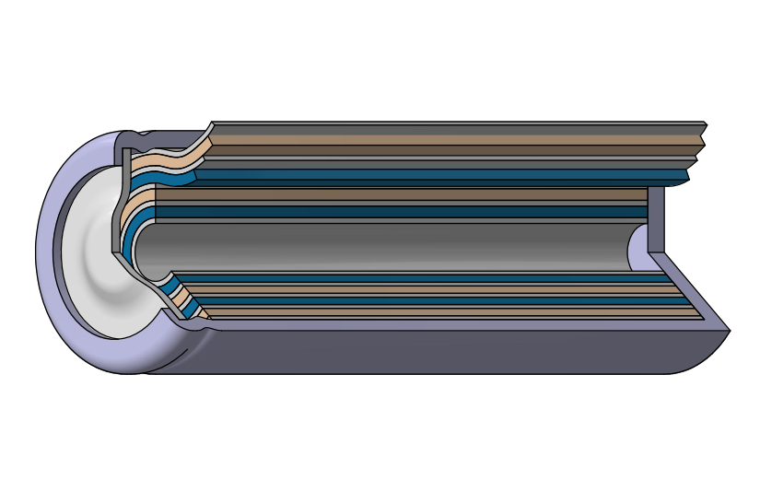
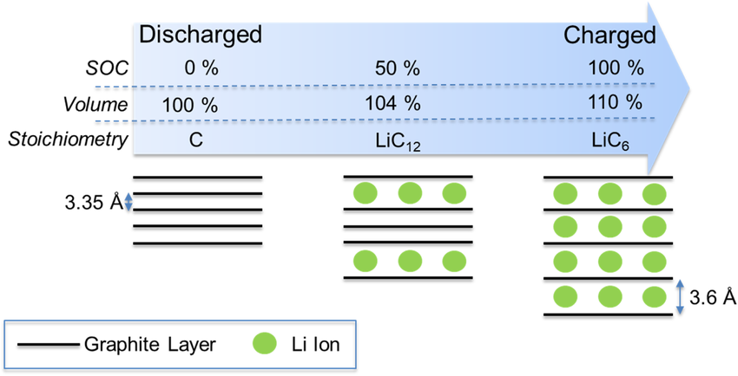
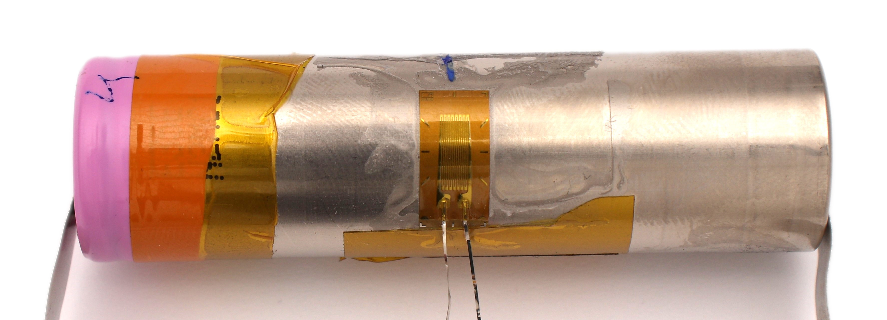
Theoretical Background – LIB
LIBs undergo mechanical property changes during their life cycle.
Reversible and irreversible mechanical changes occur during charging and discharging.
Especially the anode (graphite) expands up to ~ 10% during charging (> for Si doped anodes)
Figure 3: Schematic drawing of cylindrical cell [2]
Figure 2: Intercalation Stages of Graphite [1]
Figure 4: Applied Strain Gage on Cylindrical Cell
It is expected, that cell expands during charge → increase in measured strain
and contracts during discharge → decrease in measured strain
Can we correlate strain measurements with SOC for different cell types?
[1] G. Bree et al., “Monitoring state of charge and volume expansion in lithium-ion batteries: an approach using surface mounted thin-film graphene sensors,” RSC Adv., vol. 13, no. 10, pp. 7045–7054, Feb. 2023, doi: 10.1039/D2RA07572E.
[2] H. Popp et al., “Mechanical methods for state determination of Lithium-Ion secondary batteries: A review,” J. Energy Storage, vol. 31, p. 101859, Sep. 2020, doi: 10.1016/j.est.2020.101859.

Slide 4
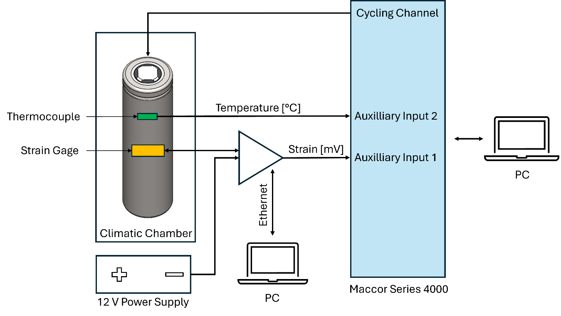
Experimental Setup
Linear Strain gage applied at SOC 0
Circumferential (hoop) strain measured
Measurements conducted in a climatic chamber to minimize environmental temperature influence
Temperature sensor placed on surface
to track cells temperature
Amplifier from HBM used:
Wheatstone Bridge in Quarter Bridge Configuration
Figure 5: Experimental setup [3]
[3] Glanz et al., J. Electrochem. Soc., 2026; manuscript in preparation

Slide 5
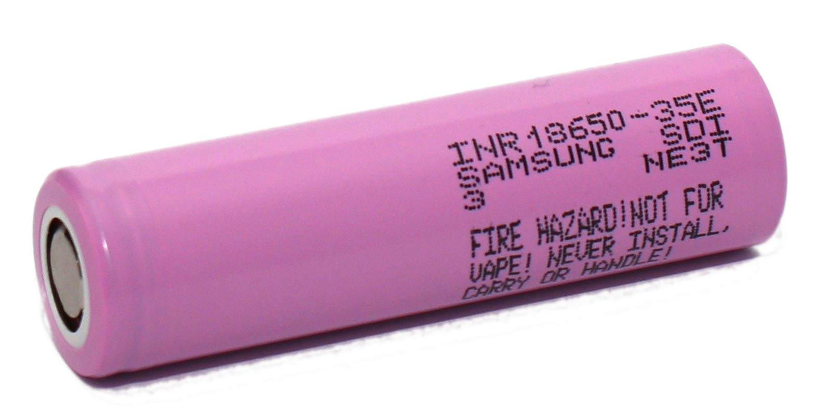
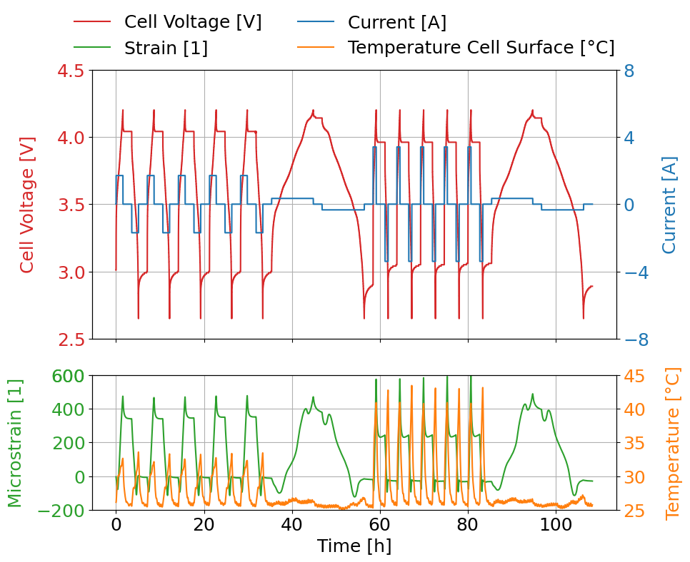
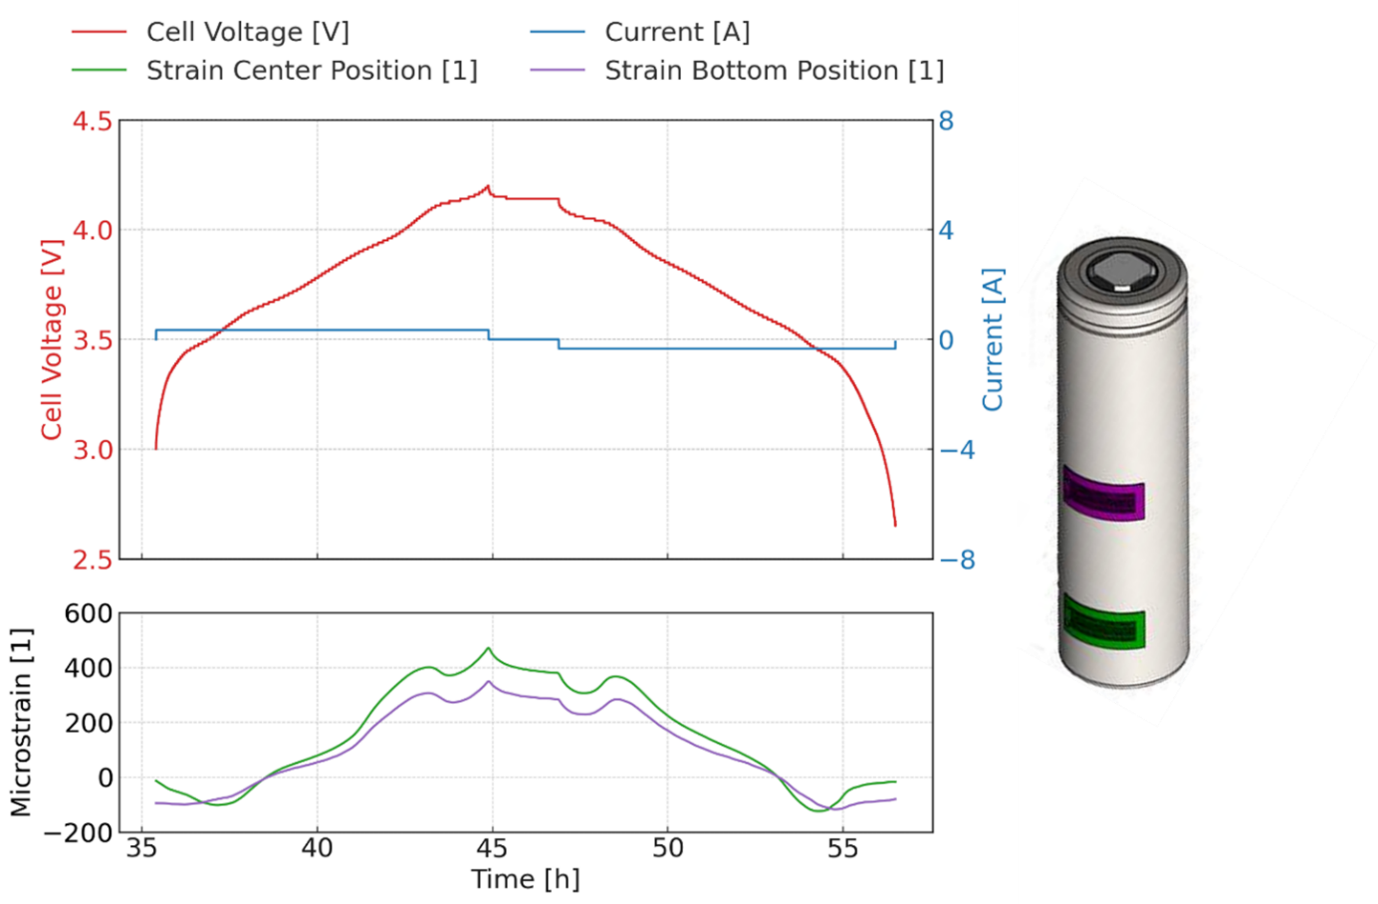
Samsung 35E
Strain gage placed at the axial centre position
Measurements conducted at room temperature (25°C)
3 different C-rates (0.1C, 0.5C & 1C)
  Results
  Increase in strain during charging, decrease during discharging
  Aligns with observations in literature
  Maximum Strain of 450 µε (0.1C)
  Due to temperature increase higher strain measured at higher C-rate
Figure 6: Measurement results of Samsung 35E

Slide 6
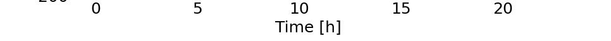
Samsung 35E
Various positions investigated → strain gage at bottom position (negative pole)
Almost constant shift in amplitude over whole SOC range → only small deviations close to SOC 0
Various 35E cells at different positions measured → all cells show similar strain behaviour
Figure 7: Measurement results for Samsung 35E of 0.1C at two different positions

Slide 7
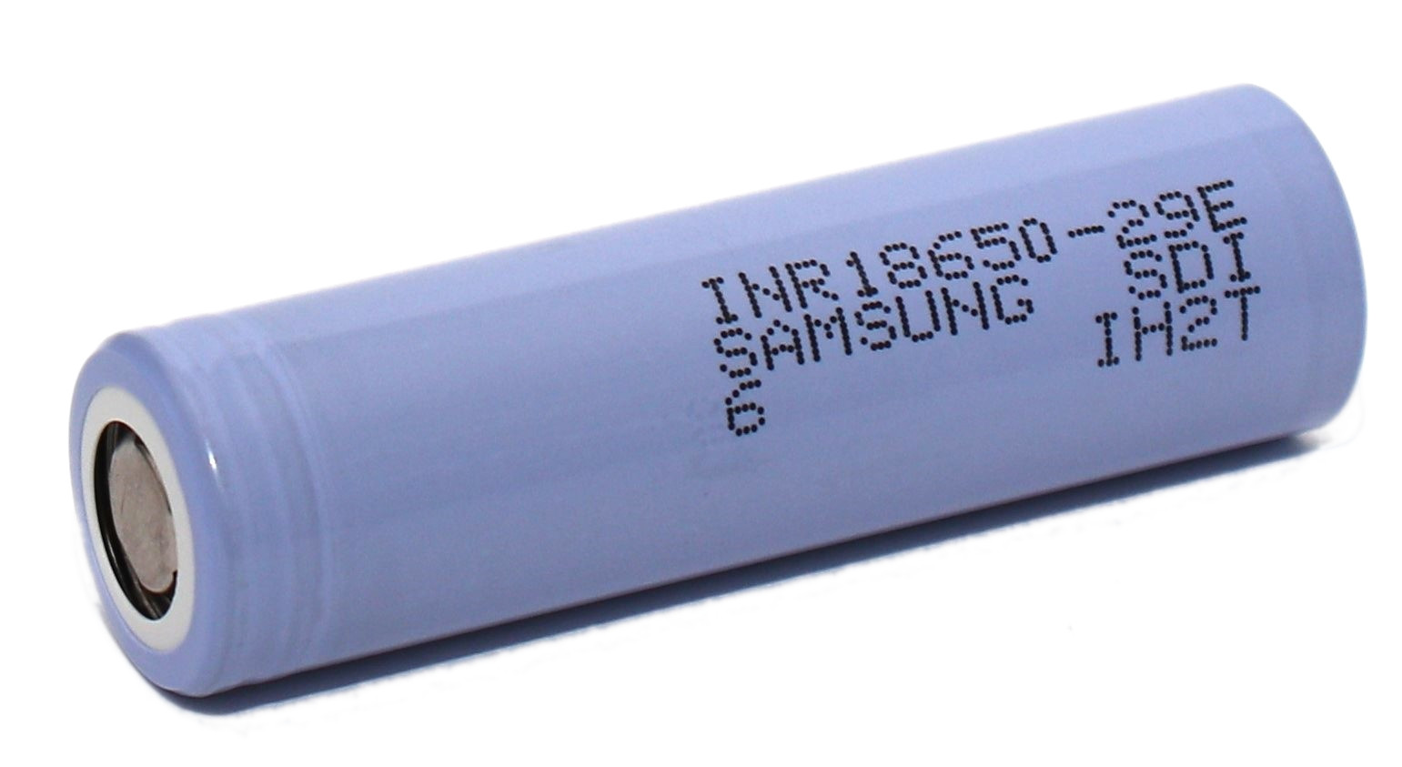
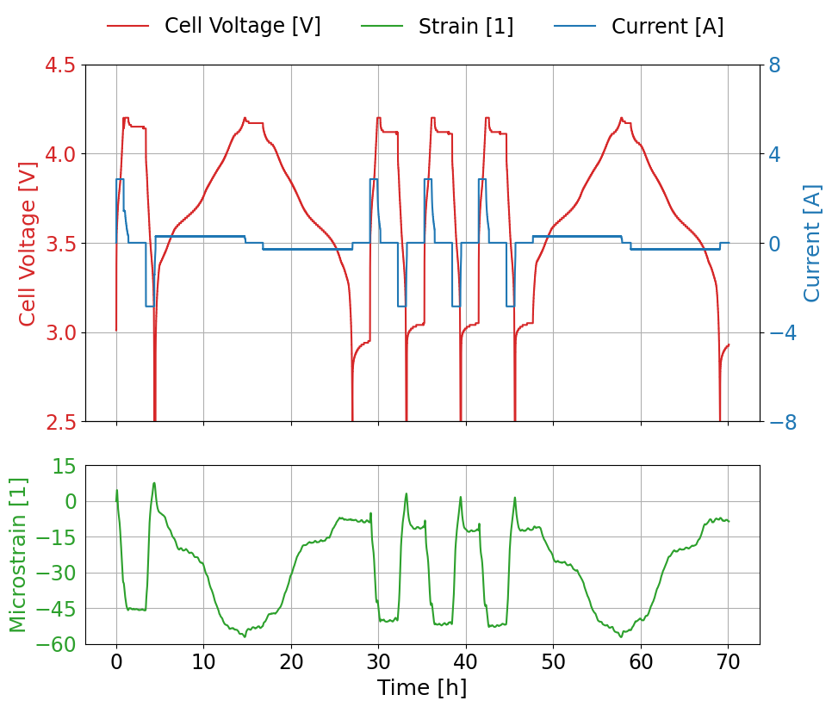
Samsung 29E
Strain gage placed at the axial centre position
Measurements conducted at room temperature
Two different C-rates (0.1C & 0.5C)
?
  Results
  Inverse strain behaviour measured:
  decrease during discharging
  increase during charging
  Does not align with underlying electro-chemical theory
  Negative Strain at SOC100 of around
  – 50µε measured
Figure 8: Measurement results of Samsung 29E

Slide 8
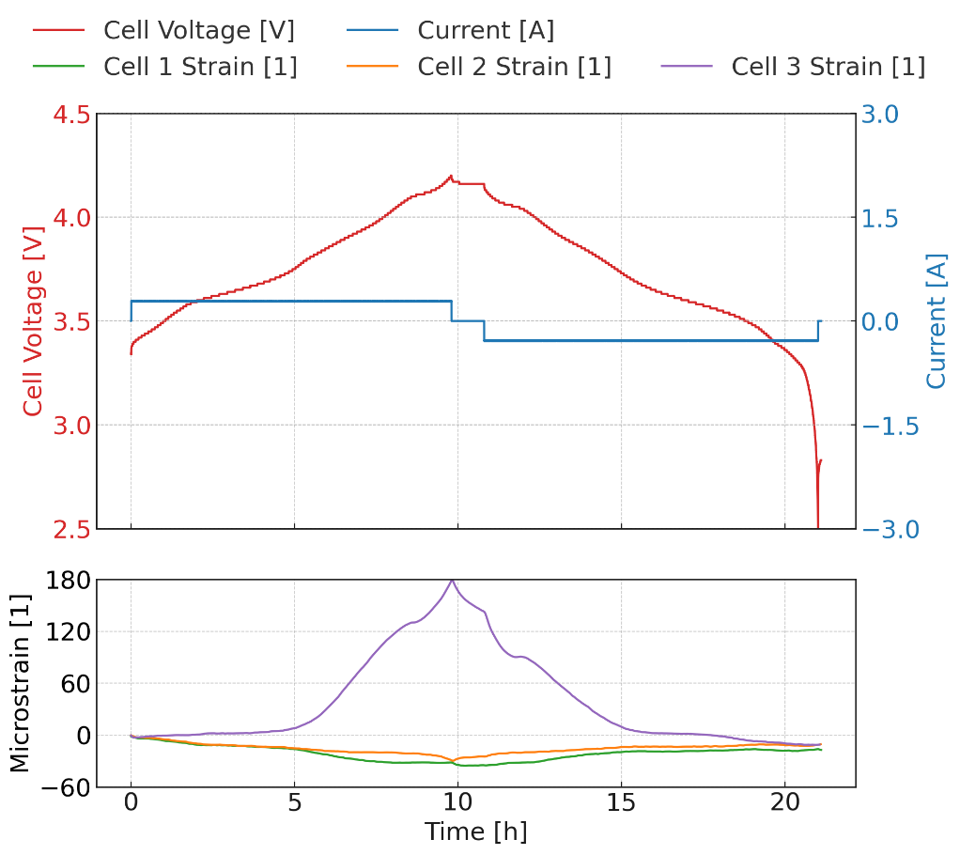
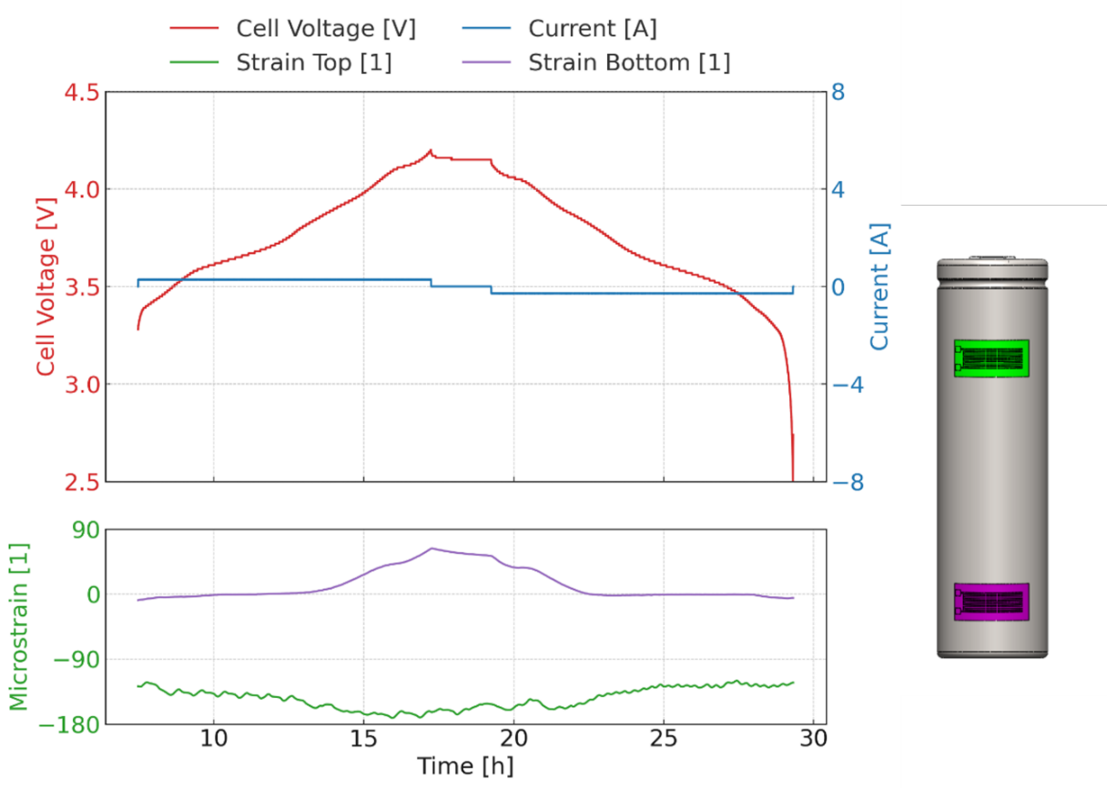
Samsung 29E
Different strain positions investigated
Only at bottom position expected strain behaviour measured → increase during charging and decrease during discharging
Figure 9: Measurement results of Samsung 29E

Slide 9
Samsung 29E
Different strain positions investigated
Only at bottom position expected strain behaviour measured → increase during charging and decrease during discharging
Figure 9: Measurement results of Samsung 29E

Slide 10
Samsung 29E
Different strain positions investigated
Only at bottom position expected strain behaviour measured → increase during charging and decrease during discharging
Measurements conducted on 3 different cells at the bottom position
Cycled at 0.1C to minimize temperature influences
2 out of 3 cells show inverse strain behaviour also at bottom position
What causes this strain behaviour / non uniform expansion?
Figure 9: Measurement results of three different Samsung 29E

Slide 11
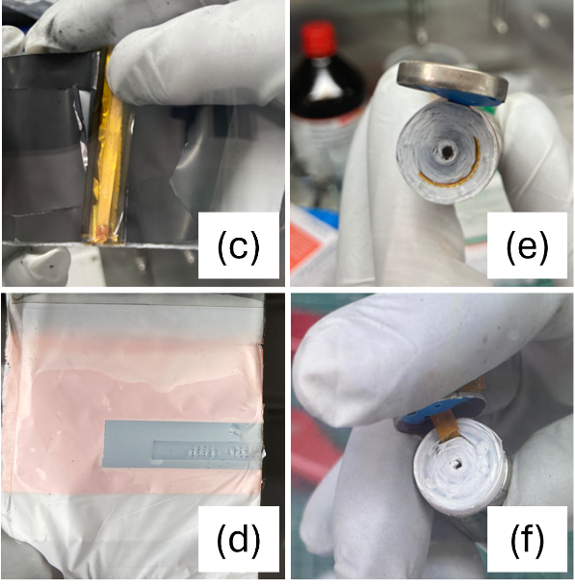
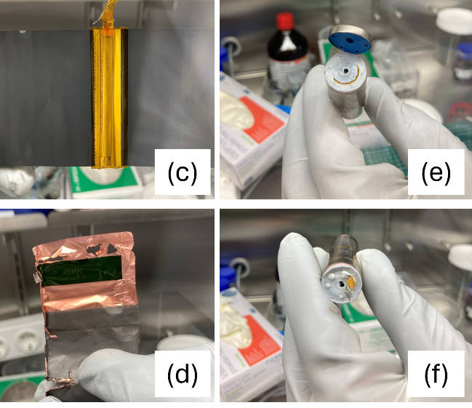
Postmortem Analysis to investigate different Strain Behaviours
Samsung 35E
Samsung 29E
Assumption: internal structure of Samsung cells is different → especially the tabs
Opened cells in Glovebox under argon-atmosphere
Exactly same tabs were used
(height, width, thickness)
a)
b)
a)
b)
XRF measurements on anode material conducted:
35E cell → silicon present
29E cell → no silicon present
→ More uniform expansion in
Samsung 35E due to silicon
c)
d)
c)
d)
Figure 10: Postmortem analysis of Samsung 35 and Samsung 29E

Slide 12
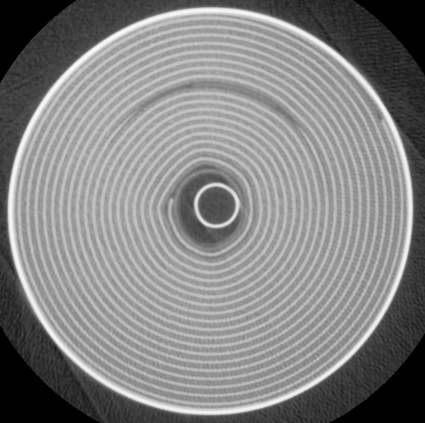
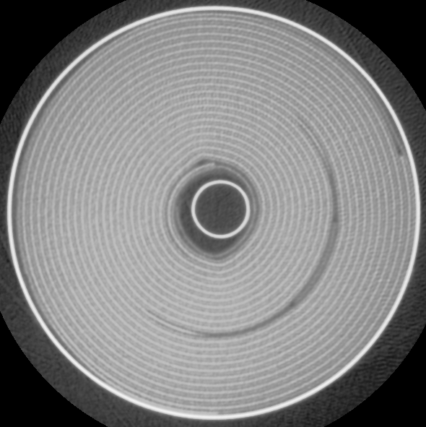
Analysis of internal structure –
Samsung 35E & Samsung 29E
CT-Scans conducted in discharged state (SOC0)
Samsung 35E
Samsung 29E
Samsung 35E
small gap between end of active material and housing
Samsung 29E
multiple gaps:
housing and jelly roll
cathode tab
in general, bigger gaps
Combination of silicon in anode material and no gaps causes non-position dependent strain results for 35E cell
Figure 11: CT scans at center position of Samsung 35E and 29E [3]
[3] Glanz et al., J. Electrochem. Soc., 2026; manuscript in preparation

Slide 13
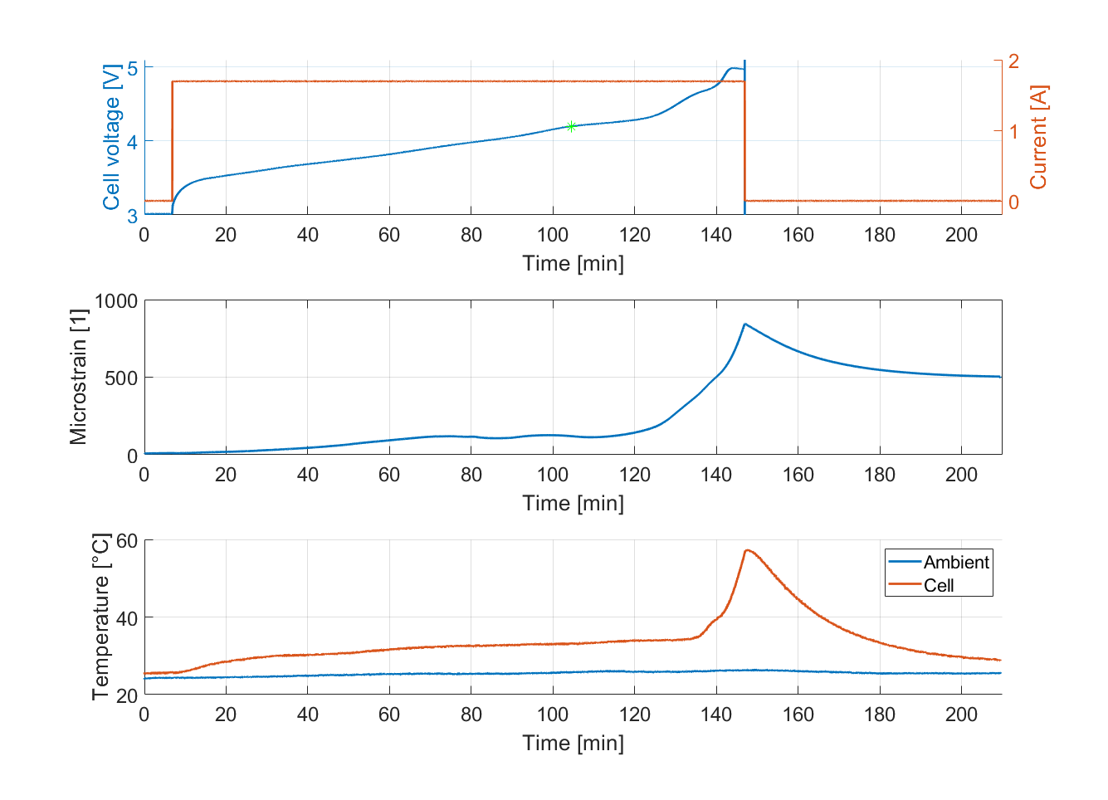
Abusive Testing – Overcharge
Samsung 35E
4.2V
Overcharged with 0.5C
CID activated
Measured strain exceeds drastically maximum strain value at SOC100
Strain increases exponentially prior to measured temperature on the cells surface
→ Detection of safety critical condition with strain gage prior to temperature sensor possible
[3] Glanz et al., J. Electrochem. Soc., 2026; manuscript in preparation
Figure 13: Overcharge test of Samsung 35E [3]

Slide 14
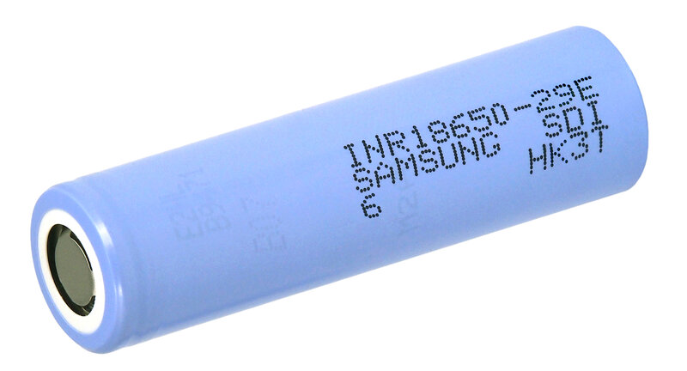
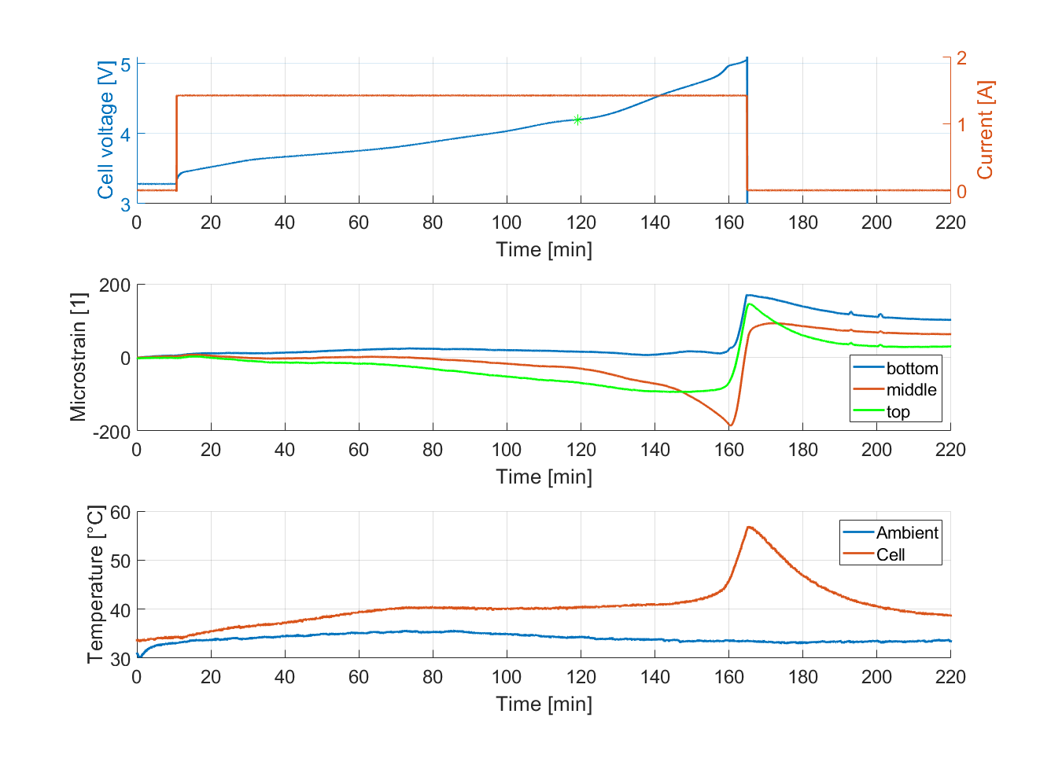
Abusive Testing – Overcharge
Samsung 29E
4.2V
Overcharged with 0.5C
Strain gages applied on 3 different positions (bottom, middle, top)
CID activated
Measured strain is different for each position
Detection of safety critical condition with strain gage prior to temperature sensor not possible
[3] Glanz et al., J. Electrochem. Soc., 2026; manuscript in preparation
Figure 13: Overcharge test of Samsung 29E [3]

Slide 15
Conclusions
Correlation between strain and SOC is not possible for all cell types
For certain cell types SOC estimation possible (ML-estimator developed)
Used active material (Si – content), packaging and manufacturing process are crucial parameters for measuring reproducible strain results
Safety critical states (overcharging) can be detected prior to standard temperature sensors without extensive characterisation (for certain cells)

Slide 16

Gregor Glanz
Gregor.Glanz@ait.ac.at

Slide 17
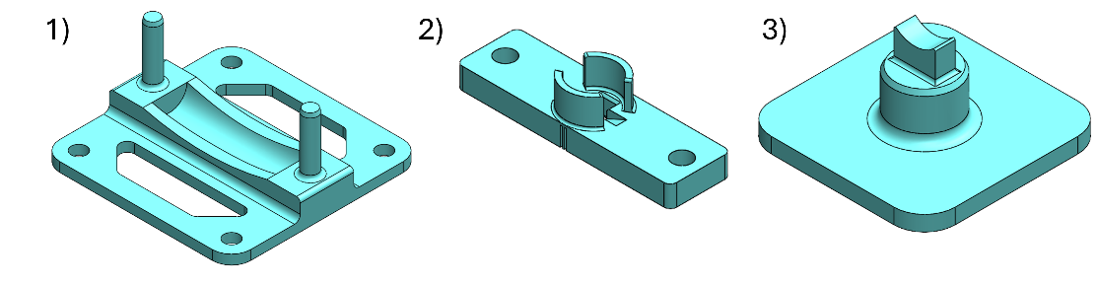
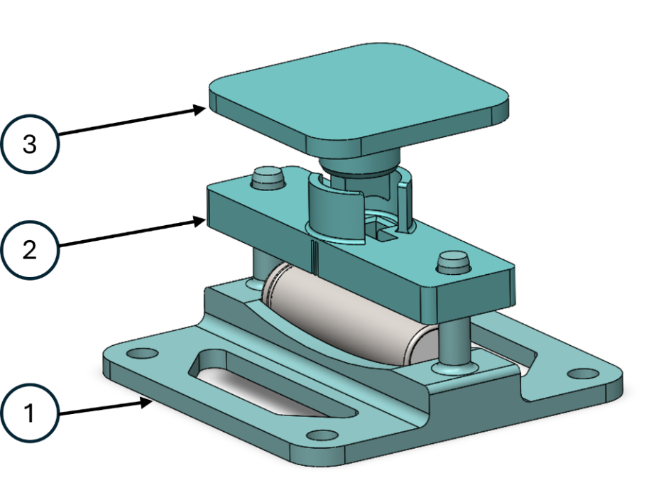
Additional Slides
Figure: Three different parts of the strain gage application device and device

Slide 18
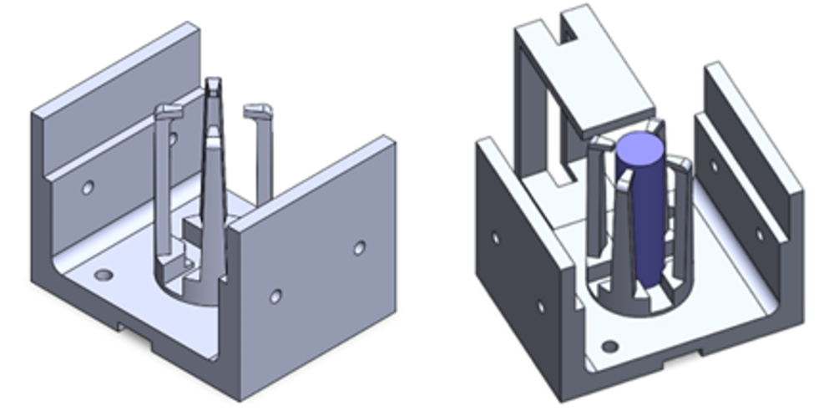
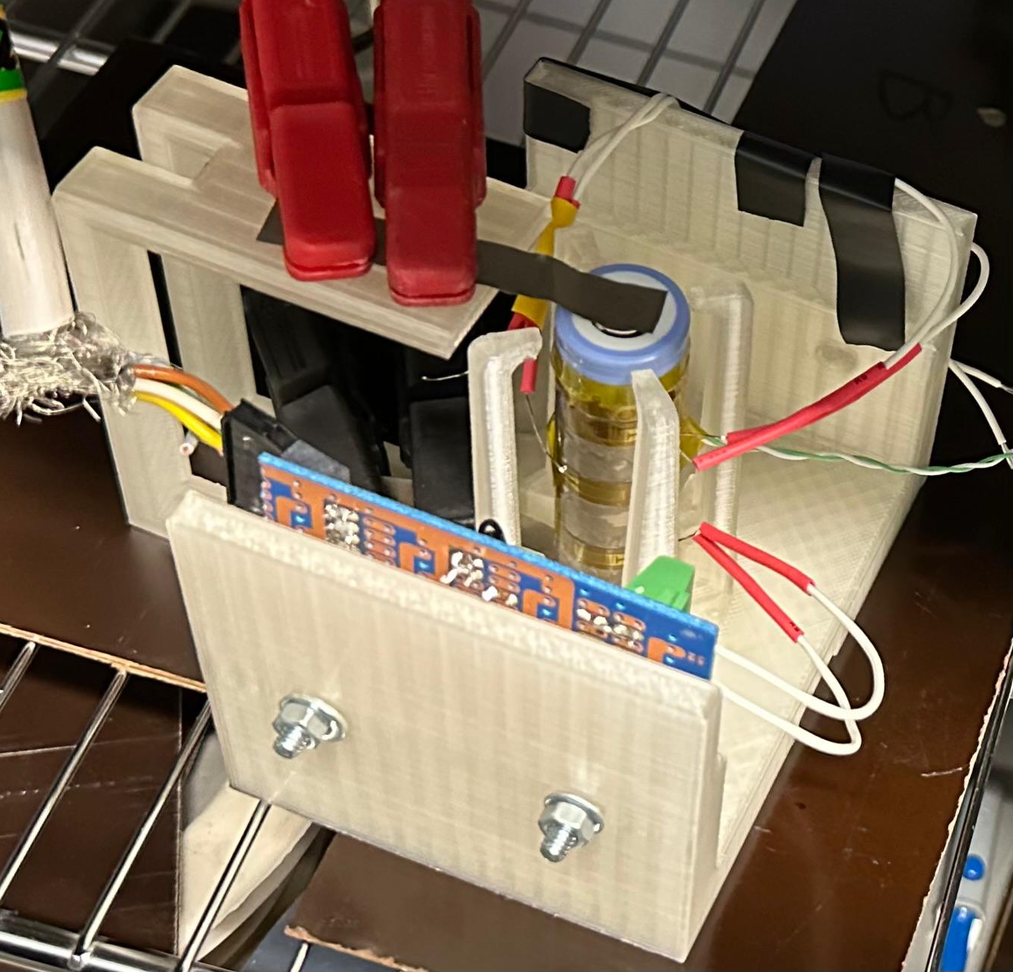
Additional Slides
Figure: Cell holder for cycling

