Slide 1

Battery2Life Webinar Battery diagnostic-sizing tool EoL battery diagnosis and 2nd life battery sizing
Izaskun Aizpurua Arconada
iaizpurua@cidetec.es
11/02/2026

Slide 2
Who is CIDETEC Energy Storage?

Slide 3





CIDETEC
CIDETEC is an organisation dedicated to applied research that integrates two internationally renowned institutes in the fields of energy storage and surface engineering.
Donostia – San Sebastián, Spain
INSTALACIONES PRINCIPALES
INSTALACIONES DE TESTEO

Slide 4






CIDETEC
An ecosystem to become leaders in energy storage in Europe across the entire battery value chain.
RAW MATERIALS
BATTERY MATERIALS
CELL
MANUFACTURING
BATTERY PACKS
APPLICATIONS
END OF LIFE
Second life batteries
Recycling
Circular economy
Mining
Refining
Materials synthesis
Electrode formulation
Separators
Electrolytes
Mixing
Electrode coating
Cell assembly
BMS
Thermal management
Mechanical design
Electromobility
Stationary storage
MODELLING &
SIMULATIONS
BATTERY TESTING

Slide 5
2nd life Battery Diagnosis-Sizing Tool

Slide 6
Challenges
Promoting the circularity of EV batteries by reusing batteries beyond their first life EoL.
Optimise battery sizing for second-life applications by comparing operating strategies.
Facilitate the integration of second-life batteries into the electricity system and promote their adoption as a sustainable solution in the energy transition.
Create an easy-to-use tool for processing data, obtaining results and displaying them clearly, which is useful for both end users and manufacturers.
Creation of a tool for sizing second-life batteries

Slide 7





Diagnosis-Sizing Tool
INPUTS
1st life data (last month)
Sorting test raw data
Equivalent Circuit Model
2nd life application requirements
Available units & diagnosed SoH/round-trip efficiency
Equivalent Circuit Model
SIZING for 2nd life
Initial sizing
Power & Energy requirements
No
Short-term DIAGNOSIS
Technical Validation
Operational limits
(V, I, FECs, EoL)
Data-driven diagnosis 1st life operation analysis
Test-based evaluation
EoL battery unit validation
2nd life application results accepted?
Economic analysis
System & operation costs
Lifespan expectancy
SoH values p.u.
Round trip efficiency p.u.
Battery unit OK/NOK
BESS energy and power ranges
XSXP configuration
2nd lifespan and cost
Yes
OUTPUTS

Slide 8
Diagnosis-Sizing Tool: Short-term diagnosis
INPUTS
1st life data (last month)
Sorting test raw data
Equivalent Circuit Model
2nd life application requirements
Available units & diagnosed SoH/round-trip efficiency
Equivalent Circuit Model
SIZING for 2nd life
Initial sizing
Power & Energy requirements
No
Short-term DIAGNOSIS
Technical Validation
Operational limits
(V, I, FECs, EoL)
Data-driven diagnosis 1st life operation analysis
Test-based evaluation
EoL battery unit validation
2nd life application results accepted?
Economic analysis
System & operation costs
Lifespan expectancy
SoH values p.u.
Round trip efficiency p.u.
Battery unit OK/NOK
BESS energy and power ranges
XSXP configuration
2nd lifespan and cost
Yes
OUTPUTS

Slide 9
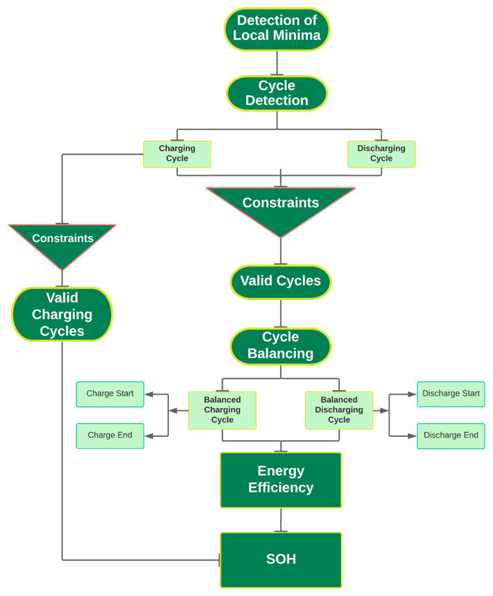
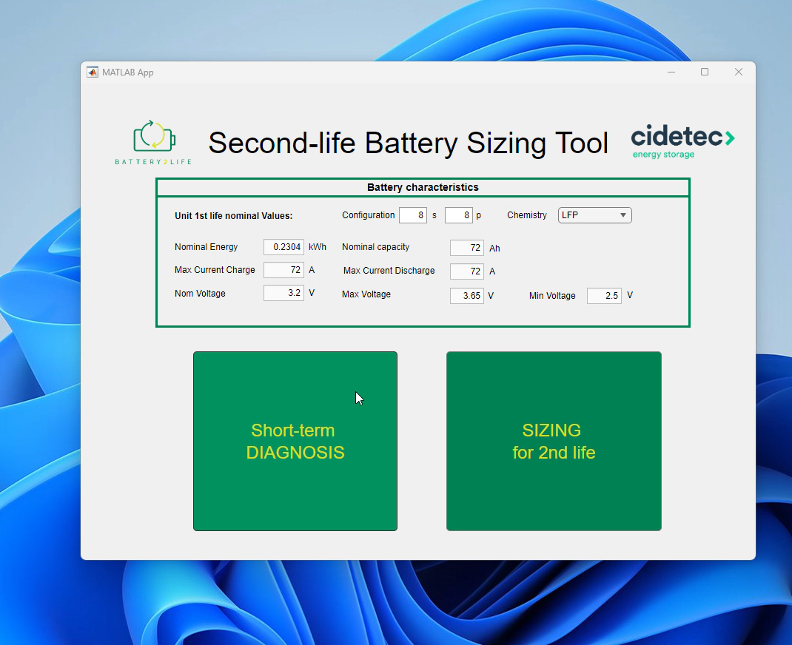
Diagnosis-Sizing Tool: Data-driven diagnosis
Short-term
DIAGNOSIS
Data-driven diagnosis 1st life operation analysis
Test-based evaluation
EoL battery unit validation

Slide 10
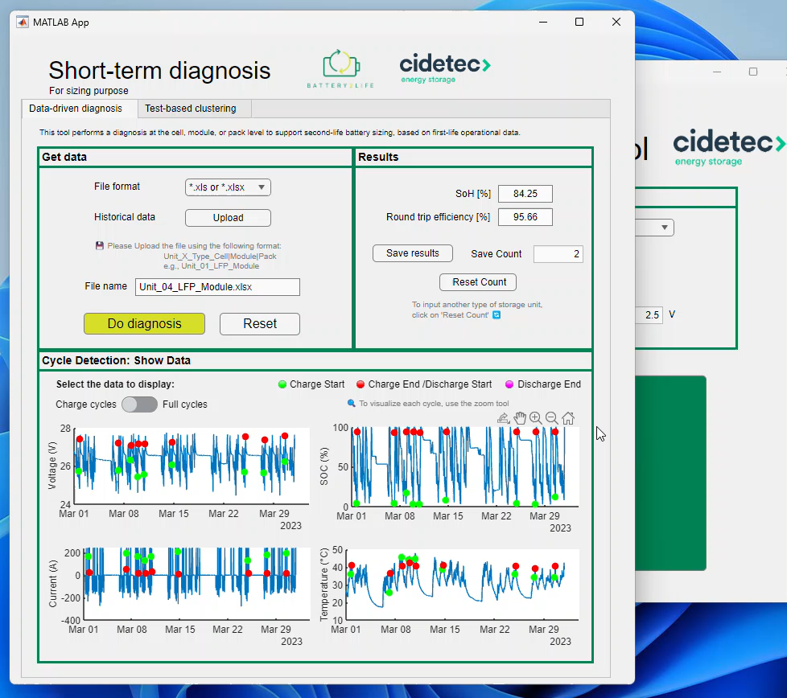
Diagnosis-Sizing Tool: Test-based evaluation
Short-term
DIAGNOSIS
UL 1974 tests
Observe
TEST 1:
3 cycles at 1C CC-CV
Capacity & capacity deviation check
Observe Tº evolution
Data-driven diagnosis 1st life operation analysis
TEST 2:
C/20 charge
24h rest
Li-plating detection
LLi & LAM (+/-)
Self-discharge
Test-based evaluation
EoL battery unit validation
TEST 3:
"HPPC" at discharge
Impedance & OCV change

Slide 11
Diagnosis-Sizing Tool
INPUTS
1st life data (last month)
Sorting test raw data
Equivalent Circuit Model
2nd life application requirements
Available units & diagnosed SoH/round-trip efficiency
Equivalent Circuit Model
SIZING for 2nd life
Initial sizing
Power & Energy requirements
No
Short-term DIAGNOSIS
Technical Validation
Operational limits
(V, I, FECs, EoL)
Data-driven diagnosis 1st life operation analysis
Test-based evaluation
EoL battery unit validation
2nd life application results accepted?
Economic analysis
System & operation costs
Lifespan expectancy
SoH values p.u.
Round trip efficiency p.u.
Battery unit OK/NOK
BESS energy and power ranges
XSXP configuration
2nd lifespan and cost
Yes
OUTPUTS

Slide 12
Diagnosis-Sizing Tool: Sizing for 2nd life
INPUTS
1st life data (last month)
Sorting test raw data
Equivalent Circuit Model
2nd life application requirements
Available units & diagnosed SoH/round-trip efficiency
Equivalent Circuit Model
SIZING for 2nd life
Initial sizing
Power & Energy requirements
No
Short-term DIAGNOSIS
Technical Validation
Operational limits
(V, I, FECs, EoL)
Data-driven diagnosis 1st life operation analysis
Test-based evaluation
EoL battery unit validation
2nd life application results accepted?
Economic analysis
System & operation costs
Lifespan expectancy
SoH values p.u.
Round trip efficiency p.u.
Battery unit OK/NOK
BESS energy and power ranges
XSXP configuration
2nd lifespan and cost
Yes
OUTPUTS

Slide 13
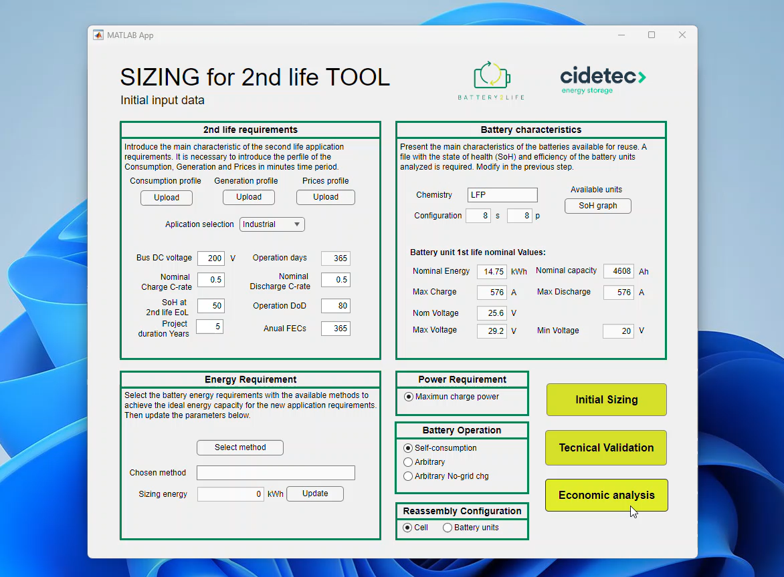
Diagnosis-Sizing Tool: Initial sizing
2nd life SIZING
Input profiles and application specifications
Initial sizing
Power requirement
Peak power from balanced profile
Technical validation
NO
Energy requirement
Valid?
Daily excess
Charge period
Accumulated energy balance
YES
Economic analysis
Initial sizing
Power 43.26 kW | Energy 196 kWh (Daily excess) | 2nd life BESS 208 kWh (0.5C ≈ 100 kW) | Configuration 8S2P (modules)

Slide 14
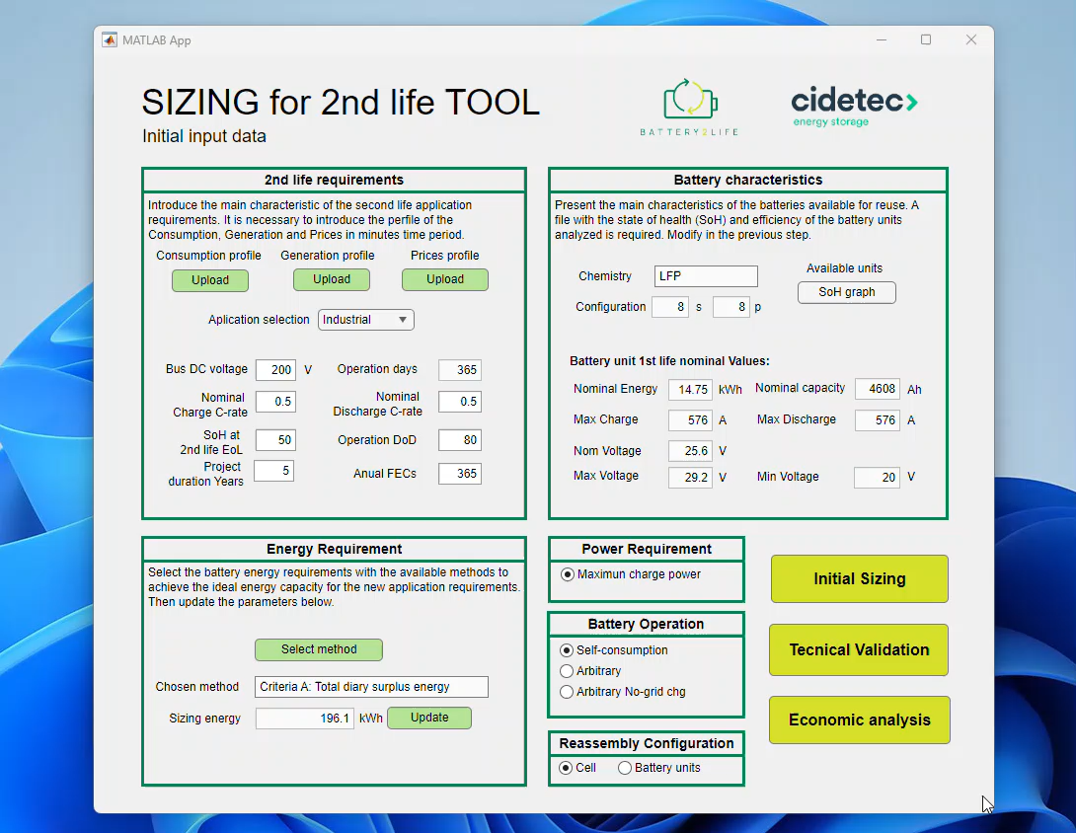




Diagnosis-Sizing Tool: Technical validation
2nd life SIZING
Voltage range limits
Ch/dch current limits
2nd life EoL
FEC number per day
Initial sizing
Technical validation
NO
Valid?
YES
Economic analysis

Slide 15
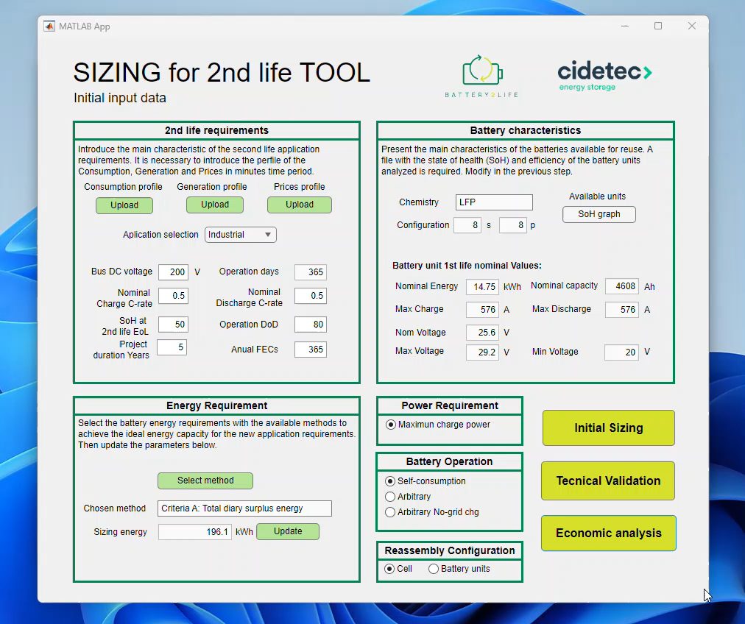
Diagnosis-Sizing Tool: Economic analysis
2nd life SIZING
Microgrid with residential consumers, 2 EV chargers and renewable generation: 46 kWp PV, 50 kW chargers, average demand of 20 kW (with >100 kW peaks). 2nd life units with 80-90% SOH.
Initial sizing
Power need 43.26 kW | Energy need 196 kWh
2nd life BESS 208 kWh | Configuration 8S2P
Technical validation
NO
Valid?
YES
Self-consumption & Arbitrage
Savings 86.95 % | CAPEX max 47.56 €/kWh
Economic analysis

Slide 16

Outcomes
It is adaptable and scalable to different scenarios and it can be useful for different agents of the value chain.
It helps the economic and technical validation of 2nd life application improving reliability.
It helps to promote reusability of batteries in stationary 2nd life applications.
It also imporves battery traceability.

Slide 17

Battery2Life 1st webinar
Izaskun Aizpurua Arconada
iaizpurua@cidetec.es

