Slide 1
Quality control procedures, disassembly handbook & disassembly of used batteries
Sotirios Efterpiou, SLG
February 11 th, 2026

Slide 2
Short Summary
Project:
Project Pillar 1 Objective: Development of a prototype Battery Energy Storage System.
Resource Circularity: Utilizing "second-life" batteries recovered from customers.
Application Source: Repurposing batteries originally used in forklifts(traction).
What we should see today:
Today’s presentation will begin with an overview of our quality control procedures and incoming inspection methodology, aligned with UL 1974 requirements.
We will then introduce the disassembly methodology as described in the handbook.
Finally, we’ll highlight key steps and visual examples from the disassembly process using selected photos.

Slide 3
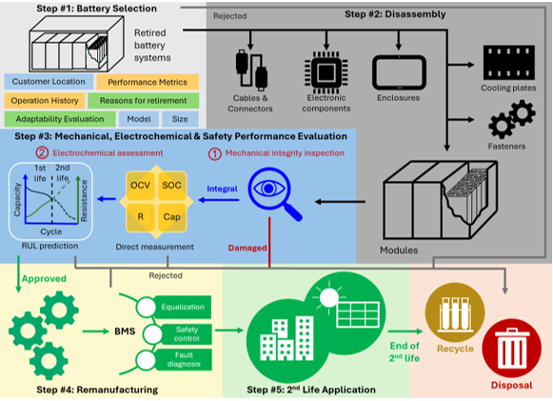
Refurbishment methodology

Slide 4
Quality Control Procedures

Slide 5
Selection Criteria and Incoming Inspection
1st life Battery pack selection criteria:
Operating hours
State of Health (SoH) of the battery pack.
Location of operation
Incoming Inspection and evaluation:
Dimension measurement test: Measurement of the module’s outer dimensions to assess potential changes (e.g., swelling) after first-life operation.
Visual inspection
Open Circuit Voltage (OCV) measurement.
High-Voltage Isolation Check
Capacity Check
Internal Resistance Check (DCIR and ACIR)
Activation – Change/discharge cycle
Discharge/Charge cycle test (temperature, voltage and current of cells and modules)

Slide 6
Disassembly Methodology

Slide 7
Disassembly Methodology and QC Battery Pack level
Initial Mechanical & Visual Inspection: Full assessment of the battery pack's structural integrity, including checks for casing damage, cracks, and corrosion on ports or terminals according to the UL1974 (18.4.1) standard.
Initial Pack Electrical Testing: Activation via charge/discharge cycle, battery capacity check according to the IEC 61960 (7.3.1) standard, and cycling to monitor temperature, voltage, and current.
Enclosure Side Plate: Removal of the battery enclosure by removing the side plates to gain internal access.
Wiring and Subsystem Disassembly: Systematic removal of all wiring interfaces, including cable connections between the battery modules, the Master Board, and all other internal subsystems.

Slide 8
Disassembly Methodology and QC Battery Pack level
Secondary Electrical Testing: Measurement of Battery Pack OCV with a multimeter, Isolation Resistance testing, and AC Internal Resistance measurement.
Module and Control Panel Decoupling: Removal of all interconnecting cables between the battery modules and the control panel interface.
Module Fixing Components Removal: Removal of all bolts, brackets, and components used to fix the modules within the enclosure.
Module Extraction: Final removal of all battery modules from the enclosure.
All the steps represent the reverse sequence of the assembly procedure.

Slide 9
Disassembly Methodology and QCModule level
Module Visual Inspection: Detailed check for casing cracks, damage, burn marks, and terminal corrosion (similar to Pack Level).
Module Dimensional Measurement: Precise measurement of module dimensions.
Module Electrical Testing & Performance: Self-Discharge tests, capacity verification, and continuous cycling with temperature, voltage, and current monitoring (similar to Pack Level).
Top Plate Removal: Disassembly of the module by removing the top plate to access cells and internal components.
Second series of Mechanical tests: Detailed check for BMS burn marks, damaged wiring, electrolyte leakage, and discoloration of insulation films (similar to Pack Level).

Slide 10
Disassembly Methodology and QC Module level
BMS Removal: Disconnection and removal of the slave unit from the module.
Inspection for cell swelling, terminal corrosion, and burn marks.
Secondary Module Electrical Testing: Measurement of module open‑circuit voltage (OCV) using a multimeter and evaluation of AC internal resistance (ACIR), (similar to pack level).This procedure enables accurate module sorting and grading, with rejection thresholds varying among manufacturers and application requirements, as guided by the principles and criteria outlined in UL 1974.
Removal of bolts from busbars and cell terminals to detach all remaining cables.
Lithium Plating Test Specialized assessment at cell level to detect lithium plating. (how we test this? Standard?)

Slide 11
Disassembly Methodology Key Insights

Slide 12
Key Insights
Reverse-engineering of the original assembly steps to ensure a straightforward disassembly process.
Integration of "2nd Life Adaptability" criteria, focusing on manufacturing process and assembly drawings during selection.
Mechanical and electrical tests throughout disassembly to ensure only safe modules proceed to 2nd life applications.

Slide 13

Battery2Life 1st webinar​
Sotiris Efterpiou
s.efterpiou@sunlight-group.com

